Slide 1
Lazy Learners

Slide 2
Lazy vs. Eager Learning
Lazy vs. eager learning
Lazy learning (e.g., instance-based learning): Simply stores training data (or only minor processing) and waits until it is given a test tuple
Eager learning (the above discussed methods): Given a set of training tuples, constructs a classification model before receiving new (e.g., test) data to classify

Slide 3
Eager vs. Lazy learning
Eager
when given a set of training tuples, will construct a generalization (i.e., classification) model before receiving new (e.g., test) tuples to classify. We can think of the learned model as being ready and eager to classify previously unseen tuples.
Lazy
When given a training tuple, a lazy learner simply stores it (or does only a little minor processing) and waits until it is given a test tuple. Only when it sees the test tuple does it perform generalization to classify the tuple based on its similarity to the stored training tuples.
Unlike eager learning methods, lazy learners do less work when a training tuple is presented and work more when making a classification or numeric prediction.

Slide 4
Lazy vs. Eager Learning
Lazy: less time in training but more time in predicting
Accuracy
Lazy method effectively uses a richer hypothesis space since it uses many local linear functions to form an implicit global approximation to the target function
Eager: must commit to a single hypothesis that covers the entire instance space

Slide 5
Lazy Learner: Instance-Based Methods
Instance-based learning:
Store training examples and delay the processing (“lazy evaluation”) until a new instance must be classified
Typical approaches
k-nearest neighbor approach
Instances represented as points in a Euclidean space.
Locally weighted regression
Constructs local approximation
Case-based reasoning
Uses symbolic representations and knowledge-based inference

Slide 6
K-NN algorithm for classification
K-NN is a supervised learning algorithm
a new instance (query) is classified based on attributes and training samples according to majority of K-NN category.
The classifier does not use any model to fit (lazy)
Given a query point, we find K number of objects (training points) closest to the query point.
The classification is using majority vote among the classification of the K objects.
K-NN algorithm uses neighborhood classification as the prediction value of the new query instance.

Slide 7
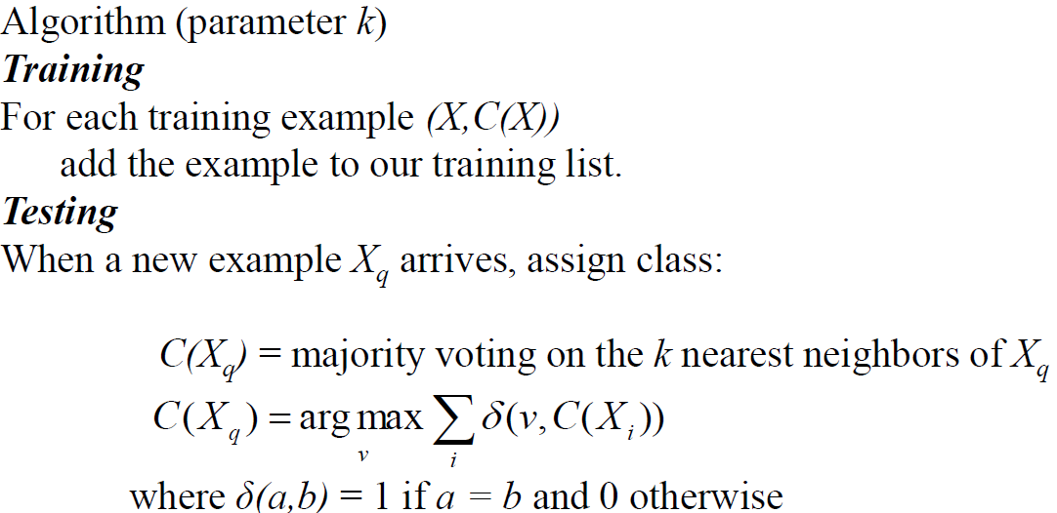
K-nearest neighbor for discrete classes

Slide 8
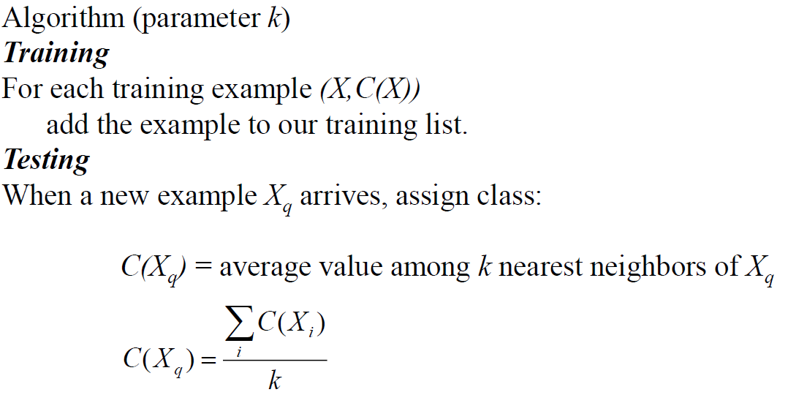
K-nearest neighbor for real valued functions

Slide 9
Algorithm
K-nearest neighbors KNN algorithm step by step:
Determine parameter K = number of nearest neighbors
Calculate the distance between the query-instance and all the training samples
Sort the samples by distance and determine nearest neighbors based on the K-th minimum distance
Gather the category of the nearest neighbors
Use simple majority of the category of nearest neighbors as the prediction value of the query instance

Slide 10
The k-Nearest Neighbor Algorithm
All instances correspond to points in the n-D space
The nearest neighbor are defined in terms of Euclidean distance, dist(X₁, X₂)
Target function could be discrete- or real- valued
For discrete-valued, k-NN returns the most common value among the k training examples nearest to x_{q}
For continuous-valued target functions, calculate the mean values of the k nearest neighbors.
_
.
.
_
_
+
_
.
.
+
.
_
x_{q}
+
_
.
+

Slide 11
Discussion on the k-NN Algorithm
k-NN for real-valued prediction for a given unknown tuple
Returns the mean values of the k nearest neighbors
Distance-weighted nearest neighbor algorithm
Weight the contribution of each of the k neighbors according to their distance to the query x_{q}
Give greater weight to closer neighbors
Robust to noisy data by averaging k-nearest neighbors
Curse of dimensionality: distance between neighbors could be dominated by irrelevant attributes
To overcome it, axes stretch or elimination of the least relevant attributes

Slide 12
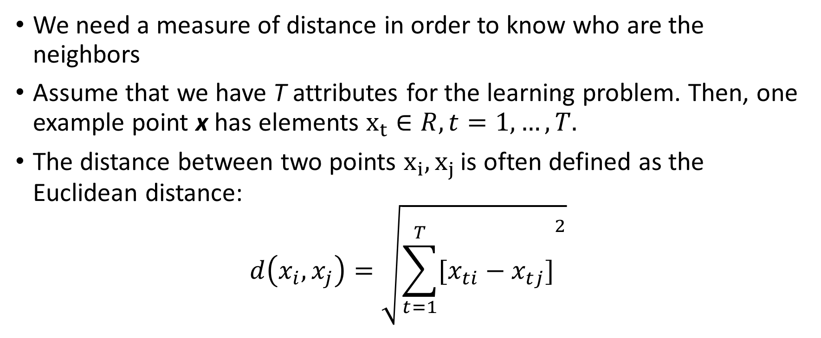
The Distance Between Examples
We need a measure of distance in order to know who are the neighbors
Assume that we have T attributes for the learning problem. Then, one example point x has elements $x_{t}∈R, t=1,…,T.$
The distance between two points $x_{i},x_{j }$is often defined as the Euclidean distance:
$$d\left(x_{i},x_{j}\right)=\sqrt{{\sum_{t=1}^{T}{[x_{ti}−x_{tj}]}}^{2}}$$

Slide 13
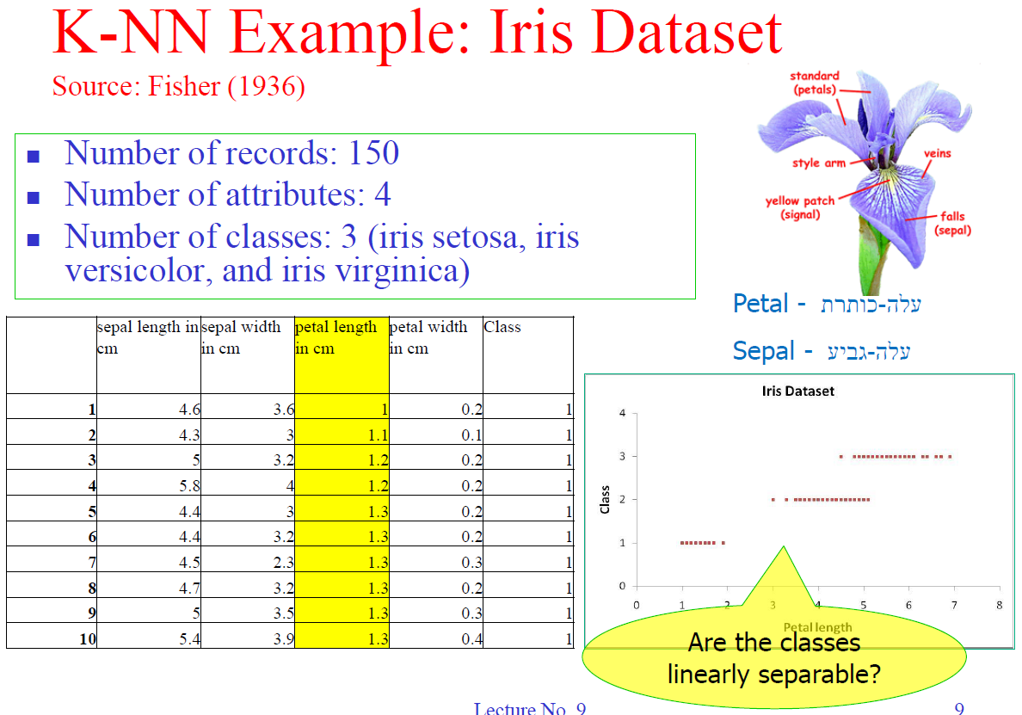
The Distance Between Examples

Slide 14
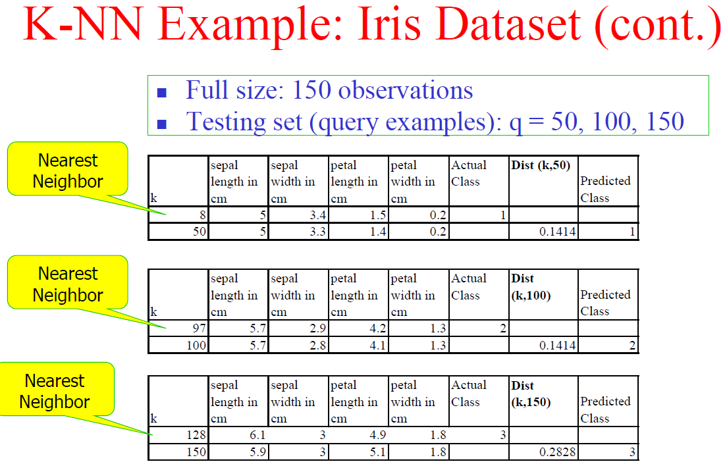
The Distance Between Examples

Slide 15
When To Consider Nearest Neighbor
Instances map to points in Rn
Less than 20 attributes per instance
Lots of training data

Slide 16
When To Consider Nearest Neighbor
Advantages
Training is very fast
Learn complex target functions
Don’t lose information
The algorithm is simple and easy to implement.
There’s no need to build a model, tune several parameters, or make additional assumptions.
The algorithm is versatile. It can be used for classification, regression, and search (as we will see in the next section).
Disadvantages
The algorithm gets significantly slower as the number of examples and/or predictors/independent variables increase.
Limited interpretability
If k is too small, the algorithm would be more sensitive to outliers. If k is too large, then the neighborhood may include too many points from other classes.
Curse of dimensionality
Distance between neighbors could be dominated by irrelevant attributes

Slide 17
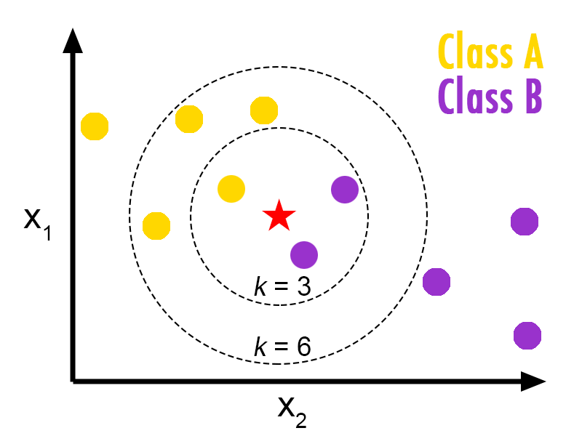
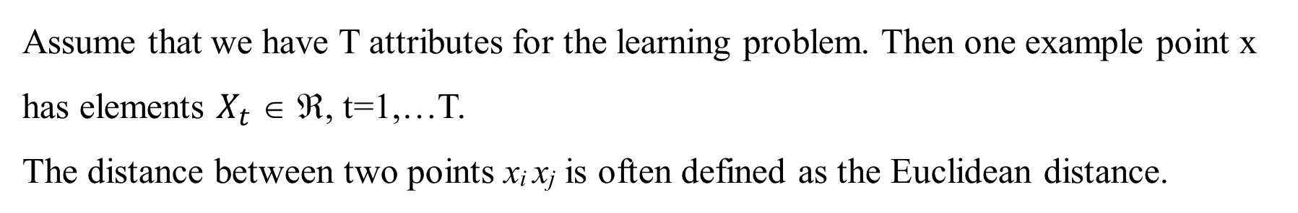
Assume that we have T attributes for the learning problem. Then one example point x has elements $X_{t}$ ∈ ℜ, t=1,…T.
The distance between two points x_{i} x_{j} is often defined as the Euclidean distance.

Slide 18
Example
We have data from a questionnaires survey (people opinions) and objective testing with two attributes (acid durability and strength) to classify whether a special paper tissue is good or not. Here is four training samples:
Now the factory produces a new paper tissue that pass laboratory test with X1 = 3 and X2 = 7.
Without another expensive survey, can we guess what the classification of this new tissue is?
Y = Classification | X2 = Strength (kg/square meter) | X1 = Acid Durability (seconds(
Bad | 7 | 7
Bad | 4 | 7
Good | 4 | 3
Good | 4 | 1

Slide 19
Example
Determine parameter K = number of nearest neighbors
Suppose K = 3
Calculate the distance between the query-instance and all the training samples
Coordinate of query instance is (3, 7),
we compute square distance (Euclidean) which is faster to calculate (without square root)
Square Distance to query instance (3, 7) | X2 = Strength (kg/square meter) | X1 = Acid Durability (seconds(
(7-3)² + (7-7)² = 16 | 7 | 7
(7-3) ² + (4-7)² = 25 | 4 | 7
(3-3) ² + (4-7)² = 9 | 4 | 3
(1-3) ² + (4-7)² = 13 | 4 | 1

Slide 20
Example
Sort the distance and determine nearest neighbors based on the K-th minimum distance
Is it included in 3-NN? | Rank minimum distance | Square Distance | X2 | X1
yes | 3 | 16 | 7 | 7
no | 4 | 25 | 4 | 7
yes | 1 | 9 | 4 | 3
yes | 2 | 13 | 4 | 1

Slide 21
Example
Gather the category of the nearest neighbors.
Use simple majority of the category of nearest neighbors as the prediction value of the query instance: we have 2 Good and 1 Bad
Conclusion: a new paper tissue that pass laboratory test with X1 = 3 and X2 = 7 is included in Good category.
Y = Category of nearest Neighbor | Is it included in 3-NN? | Rank minimum distance | Square Distance | X2 | X1
Bad | yes | 3 | 16 | 7 | 7
- | no | 4 | 25 | 4 | 7
Good | yes | 1 | 9 | 4 | 3
Good | yes | 2 | 13 | 4 | 1

Slide 22
Distance - Weighted K-NN
Replace by:
Where δ(a,b) = 1 if a = b and 0 otherwise

Slide 23
Distance-Weighted K-NN Example
x1 | x2 | y | dist(x1) | dist(x2) | dist^2 | weight | W*delta(0) | W*delta(1)
7 | 7 | 0 | -4 | 0 | 16 | 0.0625 | 0.0625 | 0
3 | 4 | 1 | 0 | 3 | 9 | 0.1111 | 0 | 0.1111
1 | 4 | 1 | 2 | 3 | 13 | 0.0769 | 0 | 0.0769
3 | 7 |  |  |  |  | Total | 0.0625 | 0.1880
=7-4
=1/13
=(2²+3²)
=0+0.1111+0.0723

Slide 24
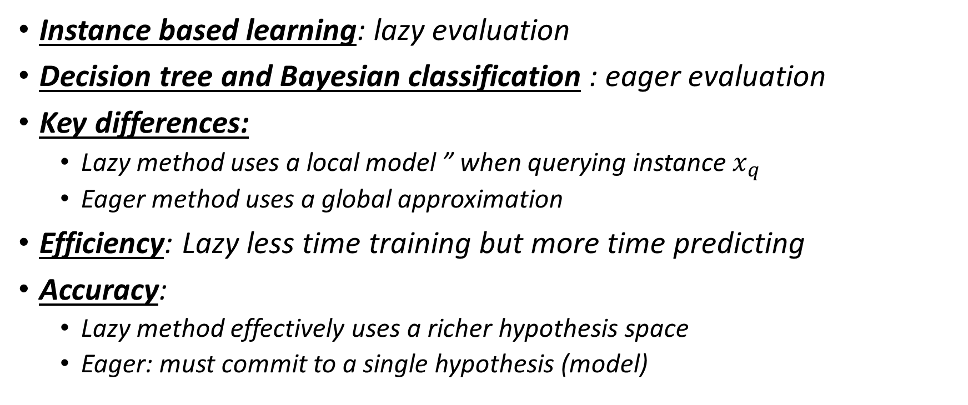
Remarks on Lazy vs. Eager Learning
Instance based learning: lazy evaluation
Decision tree and Bayesian classification : eager evaluation
Key differences:
Lazy method uses a local model ” when querying instance $x_{q}$
Eager method uses a global approximation
Efficiency: Lazy less time training but more time predicting
Accuracy:
Lazy method effectively uses a richer hypothesis space
Eager: must commit to a single hypothesis (model)

